Slide 1

Behavioral Consultation In Primary Care: Principles, Competencies and Clinical Strategies
Kirk Strosahl, Ph.D.
kirk@heartmattersconsulting.com
Winner of the 2009 APA
Practice Innovation Award
Notes:
Patti – establish self as expert
Experience – working in the field and teaching
Successes – real life examples (like the story about the BHC @ Yakima)
Why interested in working with the Institute

Slide 2
Objectives
  Examine the core features of the PCBH model
  Discuss the evidence regarding brief interventions
  Appreciate the rapid response effect in psychotherapy
  Learn the basic skills required for efficient and effective 30 minute consults
  Demonstrate a contextual model of human suffering and dysfunction
  Apply this approach to common clinical and behavioral problems seen in primary care
Notes:
Patti

Slide 3
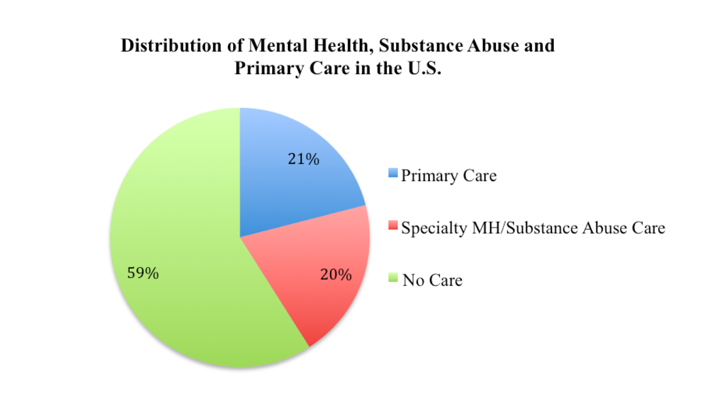
Why PCBH?
Distribution of Mental Health/Substance Abuse Care in the US

Slide 4
Why Don’t People See A Therapist?
  Lack of insurance
  Stigma
  View their problem as “physical”
  Inconvenience (including long waitlists)
  Better familiarity, comfort with PCP
  Prior negative experiences

Slide 5
Why PCBH?
Wide range of behavioral issues, ages
  Living with chronic disease
  Somatic complaints with lifestyle/stress component
  Sub-threshold problems in living
  Preventive health
  All kinds of mental health/substance abuse problems
  Infants through older adults

Slide 6
Why PCBH?
Patients with psychosocial issues are high utilizers
  Of 14 most common complaints in primary care, only 16% had organic etiology (Kroenke 1989)
  Anxiety, loneliness drive visits (Fries, 1993)
  Half of high-utilizers have a psych or CD problem (Friedman, 1995)
  Patients with psych disorder utilize 50% more primary care services (Simon et al, 1995)

Slide 7
Why PCBH?
Primary care providers can’t do it alone
  15-20 minutes per visit
  3 complaints on average/visit
  Insufficient training in behavioral interventions
  Over 3 dozen urgent but unpaid tasks everyday
  52,000 new PCPs needed to meet new demand from the ACA
  Overworked, underpaid—stressed!

Slide 8
Step 1: Appreciate the PC Mission
Characteristics of primary care:
  Integrated care
  Accessible
  Addresses a large majority of personal health needs
  Continuous care across the life span
  Practiced in the context of family and community
Benefits of well designed primary care:
  Better health outcomes
  More equitable distribution of care
  Lower health care spending

Slide 9

The Goal of PCBH
To improve and promote
overall health within the
general population
Notes:
Patti

Slide 10
Step 2: Build a Model That “Maps”
Be a GATHERer:
  Generalist
  Accessible
  Team-based
  High productivity
  Educator
  Routine care component

Slide 11
Integration Models Differ in How Well They Do This
WA State IMPACT project (co-located therapy)
  Started in 2007 in 2 counties
  Expanded to 100 CHCs and 30 CMHCS state-wide in 2009
  25,000 pts total (all years, all 130 clinics) as of 2012
PCBH model
  8,000 pts in 2012 alone at HealthPoint’s 11 clinics

Slide 12
Core Characteristics of PCBH Approach
Consultant model
Member of primary care team, work side-by-side
Goal is to improve PCP mgmt of behavioral issues
  Wide variety of interventions and goals
  Brief visits, limited follow-up
  Immediate feedback to PCP
  Any behaviorally-based problem, any age
Aim for immediate access, minimal barriers
Rooted in population health principles

Slide 13
Ways to Connect Patients with PCBH Staff
Warm Handoff
Future Appointment
Easiest Process – Instant message, text
SAME DAY PREFERRED

Slide 14
PCBH Service Array
Brief Interventions
  Directive 15-30 minute visits
  Most same day of medical visit
  Usually complete episode in 4 or less visits
  Continuity visits for more at risk patients (1:1, T/C)
  Workshops, classes (10-20%)
Pathway Services
  Assess and intervene with members of high impact group
Notes:
Patti

Slide 15
Sample Clinic Day: What to Look For
● Variety of methods for getting pt to the BHC
  ○ Before PCP
  ○ PCP and BHC in room together
  ○ After PCP
● Variety of problems and ages
  ○ Clinical (MH, SA, Beh Med, all ages)
  ○ Case management/Care coordination
● Variety in the goals of visits
  ○ PCP-prep
  ○ Care augmentation
  ○ Medication assistance planning

Slide 16
The Behavioral Health Consultant (BHC)
Dimension | Consultant | Therapist
Primary consumer | PCP | Patient/Client
Care context | Team-based | Autonomous
Accessibility | On-demand | Scheduled
Ownership of care | PCP | Therapist
Referral generation | Results-based | Independent of outcome
Productivity | High | Low
Problem scope | Wide | Narrow/Specialized
Termination of care | Patient progressing toward goals | Patient has met goals

Slide 17
Evidence For Brief Interventions

Slide 18
Some Interesting Facts About Change
Modal number of psychotherapy visits is . . .?
Average number of psychotherapy visits is . . . ?
The two biggest reasons clients seek help is . . . ?
What is the trajectory of change/benefit in psychotherapy . . . ?
What is the “rapid response” phenomenon . . . ?
What percentage of clients exhibit this phenomenon . . . ?
What is the long term outcome of clients showing rapid response?

Slide 19
Clinical Outcomes
71% of patients improved, even the most severe patients with more severe impairment at baseline improved faster than less severe
(Bryan et al., 2012)
Patients receiving just 2-3 visits showed broad improvement in sx, functioning, well-being. These changes were robust and stable during 2-year follow-up
(Ray-Sannarud et al., 2012; Bryan et al., 2009)
Most patients who attend 2, 3 or > 4 visits show clinically significant change
(Cigrang et al., 2006)

Slide 20
Symptom Reduction
● BHC patients (N=495) demonstrated significant improvements in
clinical status (as assessed by BHM-20).
  72% of pts improved across appointments
  57% of pts demonstrated clinically meaningful & reliable improvement
  Improvements also seen in those with most severe levels of distress at baseline
    Bryan, C.J., Corso, M.L., Corso, K.A., Morrow, C.E., Kanzler, K.E., & Ray-Sannerud, B. (2012). Severity of mental health impairment and trajectories of improvement in an integrated primary care clinic. Journal of Consulting & Clinical Psychology. 80 (3), 396-403

Slide 21
Decreased Psychological Distress
Patients (N=234) demonstrated statistically significant decrease in psychological distress over from first to last BHC appointment
  Measure: Outcomes Questionnaire-45 (OQ-45)
  Most common diagnoses: depression, anxiety, marital problems, chronic pain
  51% had 1 appt; 25% had 2 appts, 12% had 3 appts, 7% had 4 appts, 5% had > 4 appts
    Cigrang, J. A., Dobmeyer, A. C., Becknell, M. E., Roa-Navarette, R. A., & Yerian, S. R. (2006). Evaluation of a collaborative mental health program in primary care: effects on patient distress and healthcare utilization. Primary Care and Community Psychiatry, 11, 121-127

Slide 22
Therapeutic Alliance
Patients rated their therapeutic alliance following a first appointment with an BHC as statistically stronger than alliance ratings from a previously reported sample of outpatient psychotherapy patients
Therapeutic alliance assessed after the first BHC appointment was not associated with eventual clinical change in mental health symptoms and functioning
    Corso, K.A. Bryan, C.J., Corso, M.L, Kanzler, K.E., Houghton, D.C., Morrow, C.E. & Ray-Sannerud, B. (2012).Therapeutic alliance and treatment outcome in integrated primary care. Families, Systems, & Health, 30 (2), 87-100

Slide 23
Long Term Clinical Benefits
Patients improved from their first to last BHC appointment, with gains being maintained an average of 2 years after intervention
  Measure: Behavioral Health Measure (BHM) – 20
  N = 70
  Ray-Sannerud, B., Dolan, D., Morrow, C.E., Corso, K.A., Kanzler, K.E., Corso, M.L., & Bryan, C.J. (2012). Longitudinal outcomes after brief behavioral health intervention in an integrated primary care clinic. Families, Systems & Health, 30, 60-71.

Slide 24
Insomnia
Brief behavioral intervention with BHC associated with decreased severity of insomnia
    Goodie, J., Isler, W., Hunter, C., & Peterson, A. (2009). Using behavioral health consultants to treat insomnia in primary care: A clinical case series. Journal of Clinical Psychology, 65, 294-304

Slide 25
Detection of Suicidality
● 338 patients referred to BHCs by their PCPs in the course of routine
Treatment
  Suicidal ideation reported to BHC by 12.4% (N=42) via routine screening with BHM-20
  Only 2.1% (N=7) actually reported suicidal ideation to their PCP
  Applicability for PCBH: routine screening via written methods yields higher identification of suicidal patients in PCBH
  The “as indicated” approach is less effective as a population health screening method
    Bryan CJ, Corso KA, Rudd MD, Cordero L. Improving identification of suicidal patients in primary care through routine screening. Primary Care and Community Psychiatry. 2008; 13(4): 143-147.

Slide 26
Impact on Suicidality
● Suicidal ideation generally improved over the course of several BHC appointments
  497 primary care patients who kept 2 to 8 appointments with BHC
  Therapeutic alliance was rated very high by patients
  Alliance was not related to positive clinical outcomes
  Bryan, C.J., Corso, K.A., Corso, M.L., Kanzler, K.E, Ray-Sannerud, B., & Morrow, C.E. (2012). Therapeutic alliance and change in suicidal ideation during treatment in integrated primary care settings. Archives of Suicide Research, 16, 316-323.

Slide 27
Impact on PTSD Symptoms
Pilot study of 15 active duty military members with deployment-related posttraumatic stress disorder (PTSD)
  Used Prolonged Exposure and some optional theme processing elements from CPT
  Patients attended an average of 4.5 30-minute appointments
  50% of tx completers did not meet criteria for PTSD at the 1-month follow-up assessment.
  No SI thoughts, behaviors or plans
  Cigrang, J. A., Rauch, S. A. M., Avila, L. L., Bryan, C. J., Goodie, J. L., Hryshko-Mullen, A., Peterson, A. L. (2011). Treatment of active-duty military with PTSD in primary care: Early findings. Psychological Services, 8(2), 104-113.

Slide 28

PCBH Evidence: Depression
Review of 12 RCTs (Schulbert 2002)
Evidence-based psychotherapies adapted for PC are comparable to RX alone (supported by Psych) and superior to UC
Impact of embedded BHCs (Serano, 2011)
  Reduced referrals to MH (only 8% referred)
  Improved adherence to evidence-based guidelines
  Reduced RX for anti-depressants
Notes:
Patti

Slide 29
Complex Patients
Among patients with suicidal symptoms, depression, and PTSD, BHCs provided treatment
  No direct relationship found between PTSD and suicide
  Suicidal symptoms explained exclusively by depression
  Applicability for PCBH: if patients with trauma, depression, and suicide present in primary care, do NOT begin treating PTSD – depression symptoms should be treated first providing suicide risk has already been assessed and addressed
  Bryan CJ, Corso KA. Depression, PTSD, and suicidal ideation among active duty veterans in an integrated primary care
  clinic. Psychological Services. 2011; 8(2): 94-103.

Slide 30
Getting Started

Slide 31
Consultant Vs. Therapist
Consultants answer a specific referral question
Job is to help the referring medical provider with decision making and picking effective strategies
Consultant has to answer the referral question first and foremost
Medical provider is the primary customer, client is a secondary customer
Ownership of care planning stays with medical provider
Consultant has to build the practice by selling the service!

Slide 32
Orient Your New Colleagues (PCPs, RNs, Medical Assistants, Front Desk)
Who to refer
How to refer
What to say
What to do when someone is ambivalent
How to involve the BHC in follow up medical visits

Slide 33



BHC Practice Habits Based on Evidence
Provides “behavioral prescriptions” for skill practice and monitoring at follow-up (associated with improved outcomes)
Uses empirically supported treatments that have been shown to contribute to improved clinical outcomes in fewer treatment sessions across a diverse outpatient population without exclusion
Notes:
Patti

Slide 34
Basic BHC Behaviors
Hang out in the heart of the clinic (nurses area)
Schmooze, schmooze, schmooze!
Portable computer allows concordant charting
Access to printer and library of patient education materials
Real time communication system with providers
Use exam rooms if available but be sensitive to clinic flow

Slide 35
Clinical Practice Competencies

Slide 36
Starting Assumptions
Assumptions about suffering
  Symptoms are the “output”, not the “input”
  Emotions are results of daily inputs, not problems to be solved or eliminated
  There is a dynamic balance between life stress and positive coping behaviors
  Little changes in this dynamic can produce big symptom displays
  The goal is to understand the clients life context, within which the “problem” is nestled
Notes:
Patti

Slide 37
Starting Assumptions
Assumptions about Behavior Change
  Maladaptive behaviors are learned and maintained by various external and internal factors
  Many maladaptive behaviors occur as a result of skill deficits
  Direct behavior change is the most powerful form of human learning
  Small behavior changes can have a dramatic effect on life context and symptom distress
Notes:
Patti

Slide 38
Core Competencies: Initial Consult
Physician refers to BHC for specific problem / question
Introduction
5 minutes
Snapshot
5 minutes
Functional Analysis
5 – 10 minutes
Problem Summary/Behavior Change Plan
5 – 10 minutes
Charting/Feedback to PCP
5 minutes
Patient implements behavior change plan, returns for follow-up as needed
Clinician review recommendations; retains full responsibility for patient care decisions

Slide 39
Clinical Skills: Initial Visit
Introduction
Life Context Questions & Functional Analysis
Outcome Measure
Problem Summary Statement
Behavior Change Goal
Charting & Feedback

Slide 40

The Most Important Two Minutes is the First Two:
Hi! I am Mary Virginia
To help your PCP help you
Your PCP calls me in to help when there’s a concern about mental, physical or social health
My job as a consultant to you and your PCP is quite specific
We will spend about a 20-25 minutes today . . .
Notes:
Patti
It starts most often with PCP referral, but patients may also self-refer (if they are patients at the clinic).
Then, the BHC flow continues. . .

Slide 41
The Most Important Two Minutes: Cont.
We will come up with a plan and I’ll share that with your PCP
Some people come back to see me to learn more skills and address other concerns; some only see me one time
Okay, let’s start with this brief survey; it will give us some numbers about your overall quality of life over the past week
Notes:
Patti
It starts most often with PCP referral, but patients may also self-refer (if they are patients at the clinic).
Then, the BHC flow continues. . .

Slide 42
The Love, Work, Play & Health Questions
Love | Where do you live? With whom? How long have you been there? Are things okay at your home? Do you have loving relationships with your family or friends?
Work | Do you work? Study? If yes, what is your work? Do you enjoy it? If no, are you looking for work? If no, how do your support yourself?
Play | What do you do for fun? For relaxation? For connecting with people in your neighborhood or community?
Health | Do you use tobacco products, alcohol, illegal drugs? Do you exercise on a regular basis for your health? Do you eat well? Sleep well?
16
19

Slide 43
The Three T & Workability Questions
Time | When did this start? How often does it happen? What happens immediately before / after the problem? Why do you think it is a problem now?
Trigger | Is there anything--a situation or a person--that seems to set it off?
Trajectory | What’s this problem been like over time? Have there been times when it was less of a concern? More of a concern?
Workability | What have you tried (to address the problem)? How has that worked in the short run? In the long run or in the sense of being consistent with what really matters to you?
17
20

Slide 44
Problem Summary
Express empathy / engage the patient (“This sounds very difficult and I can see that you’ve tried . . .)
Strategic Reframe: Simplify and reduce the magnitude of the problem (“So, you’ve bee feeling a lot of stress since loosing your job and it appears to affecting your ability to relax and to sleep at night.”)
Help patient generate new strategies (“If a miracle happened . . . “)
Create a do-able framework for change (“Let’s take it one step at a time. I think the first step could be x or y; what makes sense to you?”)

Slide 45
In Session Rating Scales
How big of a problem is this for you? On a scale of 0 = “not a problem” and 10 = “a very big problem”, how would you rate it?
How confident are you that you will follow through with our plan? Use a scale where 0 = “no confidence” and 10 = “very confident”.
How helpful was this visit? Use a scale where 0 = “not helpful” and 10 = “very helpful”.

Slide 46
Behavior Change Basics
Focus on function, not cure (“My job is to help you and your doctor improve your overall quality of life; often one or two small changes in our daily routine can make a big difference over time.”)
Process Check (“So at this point you are interested in . . . ?)
Assess patient values related to problem (“In terms of what you think is really important in life--your core values--why does this change seem important at this time?”)

Slide 47
Behavior Change Plan
Look for patient strengths to use in plan
Emphasize idea of small positives
Use external supports to promote success
Frame plan as an “experiment”; collect data
Assess patient confidence in plan
Predict imperfection
Provide a written copy of plan (on RX pad)

Slide 48
Team-Based Behavior Change Intervention:
The Bulls Eye Plan
Your Clinic
Your Phone Number
Love Work Play
Plan: _________________________________________________
______________________________________________________
______________________________________________________

Slide 49
Interventions: General
Basic behavior change (self-reinforcement)
Build social support
Suggest pamphlet or hand out
Suggest book (Living with Children, I Can If I Want To, Living Life Well)
Refer to community resources
Suggest Internet programs (Insomnia, UCANPOOP 2, mild depression)
Notes:
Choose 2, one for AM and one for PM

Slide 50
Interventions for Common Problems
Eating, Sleeping, Engaging in Social Activities, Engaging in Exercise
Medical Problems: Basic Interventions (Addressing stigma, creating a values context, recognizing primacy of psychosocial stresses; one step at a time)
Overweight / obesity; diabetes; hypertension; ADHD
Substance Abuse
PTSD
Medication Issues

Slide 51
Interventions: Depression
(or Fatigue, Insomnia, loss of interest)
Demystify depression, focus on symptom of concern
Ask about patient’s world view
Explain the “lethargy cycle”
Make behavioral activation plan, particularly social activities
Problem solving
Notes:
Choose 2, one for AM and one for PM

Slide 52
Interventions: Anxiety
Teach relaxation / mindfulness / acceptance strategies
Square breathing for panic
CALM or diaphragmatic breathing
Set up self-guided exposure (based on values)
Notes:
Choose 2, one for AM and one for PM

Slide 53
Interventions: Sleep
Use Handouts
Review Sleep Hygiene Guidelines
Coach on mindfulness and relaxation in bed
Maintain sleep schedule
Morning exercise
Very common and high impact problem, so offer monthly workshops
Notes:
Choose 2, one for AM and one for PM

Slide 54
Interventions:
Chronic Disease / Lifestyle
Motivational Interviewing (Decisional Balance Sheet)
Team-based support of specific goals (Bulls-Eye or SMART goals)
Classes and workshops, group medical visits
Internet-based with BHC phone call support
Bibliotherapy (The Diabetes Lifestyle Book by Gregg)
Notes:
Choose 2, one for AM and one for PM

Slide 55
Interventions: Relationship Problems
Parenting Stress
  Parenting Protocol (play, positive and descriptive praise, ignoring)
  Enuresis (The Good Kid Book)
  Overweight / obesity prevention
Marital Satisfaction
  See Relationship Couples Handout
  Use Problem Solving
  Caring Bank Account
  Marital Check-up
Notes:
Choose 2, one for AM and one for PM

Slide 56
Practice Management Skills
Staying on-time, adjust time (10-15 minute sessions if needed)
Keeping apt open, use classes/groups to increase your capacity
Pair follow up visit with a PCP appt to reduce no shows
Utilize alternative patient contact methods (phone follow ups, patient portal)

Slide 57
Schedule Template
Time | Activity Type
8:30 | RT
9:00 | SD
9:30 | RT
10:00 | SD
10:30 | RT
11:00 | SD
11:30 | RT
Time | Activity Type
1:30 | SD
2:00 | RT
2:30 | SD
3:00 | RT
3:30 | SD
4:00 | RT
4:30 | SD
Notes:
Choose 2, one for AM and one for PM

Slide 58
Curbside Consults
In person for initial, same-day
Be brief, get to the point and avoid jargon
OK to interrupt PCP if you need immediate action
Make sure to clearly answer the referral question and state your recommendations
SKILL PRACTICE: With partner, give FB on initial visit; follow-up visit (role play demonstration)

Slide 59
Charting
This is a consult note, not a progress note
Be brief and highlight core findings
Avoid use of jargon
Chart concordantly to save time
Three main components:
  Restate the referral question
  Core assessment findings and problem impression
  Recommendations to patient/provider and actions you took with patient today

Slide 60
Clinical Skills: Follow-up
Assess Improvement
Outcome Measure
Functional Analysis
(if needed)
Problem Specification
• Conceptualization
• Teaching New Behavior
Charting & Feedback
Implement Plan

Slide 61

Follow-Up Appointments
Often more brief (15-20 minutes)
No introduction or life context questions; allows more time for focus on reviewing success of interventions / teaching new skills
Begins with outcome questions (Duke or PSC, Visit Rating Scale)
Review progress with behavior change plan; trouble shoot problems with follow through, reinforce any attempt at change, normalize lack of success
If making progress, cease planned f-u; leave door open for easy access

Slide 62
Classes
Generic
Open Access
Psycho-educational
Continuity statements
Usually 1 hour
Use feasible assessment and chart
Announce in Exam Room Posters
Notes:
Choose 2, one for AM and one for PM

Slide 63
Groups
Monthly
On-going management
On-going skill training
Measurement of outcomes over time
Often related to pathway
May be drop-in or required
May be lead by BHC / BA alone or co-led with PC Team members
Notes:
Choose 2, one for AM and one for PM

Slide 64
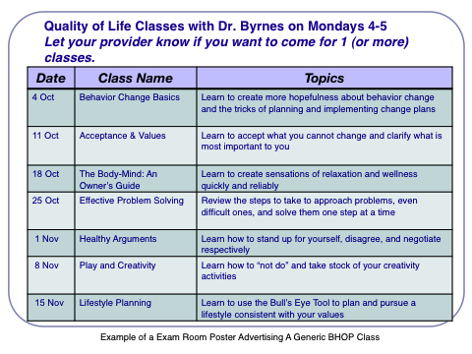
Interventions: Depression/Anxiety
Notes:
Choose 2, one for AM and one for PM

Slide 65
PCBH Pathway Services
Targets a patient population that has high impact (by numbers or by way of presentation)
Applies the evidence for the care of the targeted population
Respectful of local resources
Seeks to improve efficiencies
Measurement of outcomes planned
Notes:
Patti
Developed by a team; linked with QI

Slide 66
PCBH Pathway Services May Include…
Screening Processes
  Neurodevelopmental screening at 18- and 24-month well-child visits and exam room posters
One-on-One Interventions
  BHC consult at any 2-year old well-child where child is overweight
Classes or workshops . . . Or ultra-brief checks
  Sleep hygiene, smoking cessation
  Visit check-in screen: Do You Want to Make A Lifestyle Change?
Notes:
Patti
Talk about Jeff’s: Do You Want to Make a Lifestyle Change? Check-in screening.

Slide 67
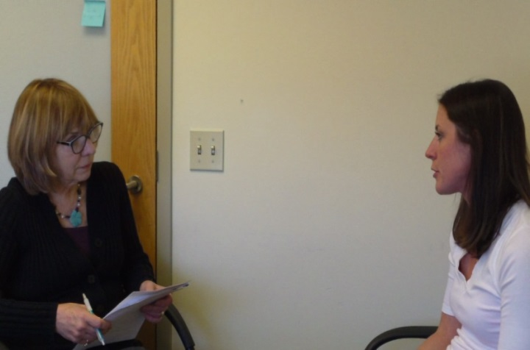
PCBH Pathway Services May Include…
Group medical visits
  Chronic pain
  Unstable diabetes
  Weight control
Notes:
Patti

Slide 68
Questions, Evaluations
Thank you for your precious time!
Please complete a session evaluation.
Notes:
KE: We will have flip charts and markers available for you in case you want/need to keep a parking lot of questions or ideas and go back to them at the end of the day.
PR: Great I love parking lots☺

